Slide 1

The BDK Distributed Database for USC Public Safety
DSCI 551 Distributed Database Project, Sp. 2024
Rodney Meeler, Daniel Lee, Kyle Parker
Team 6

Slide 2
Overview
This presentation will provide a visual overview of the web application user interface connected to our databases to highlight their features.
Specific design, functionality, and user experience aspects will be addressed for each page.
Application is hosted at: http://3.216.130.143

Slide 3
Pages on Application
Home
Search
Admin Gateway
Failed Password Check
Admin Page
Crime Submitted
Crime Updated
Crime Deleted

Slide 4
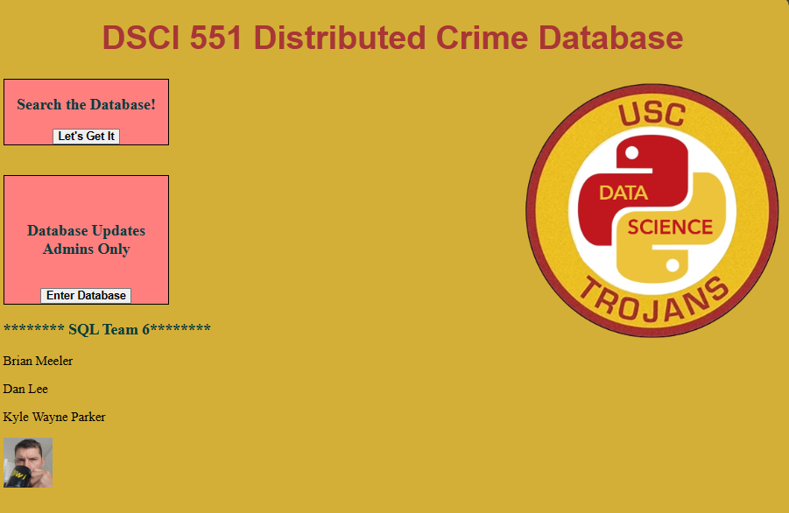
Home
Search function at top/left of body, where we start reading, ensuring the most used feature is seen first.
Areas with buttons for users in high contrast boxes, to enable rapid identification.
Team information at bottom.

Slide 5
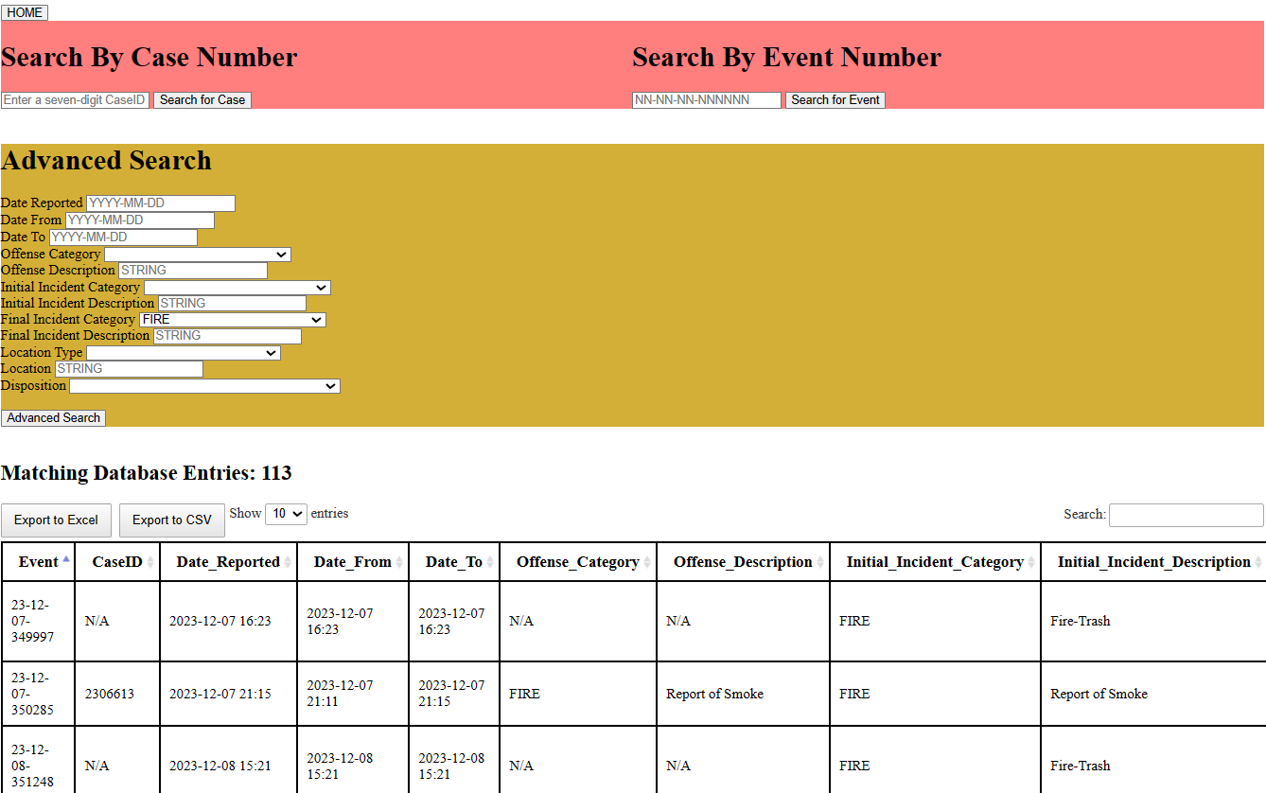
Search
Simple search at top of page, again in high contrast box.
Advanced Search beneath, contrasting box to simple search and results.
All search fields have drop-down or properly formatted placeholders.
Number of matches presented above results table, with export buttons underneath for rapid download.
Search window for additional filtering.
Sortable columns.

Slide 6
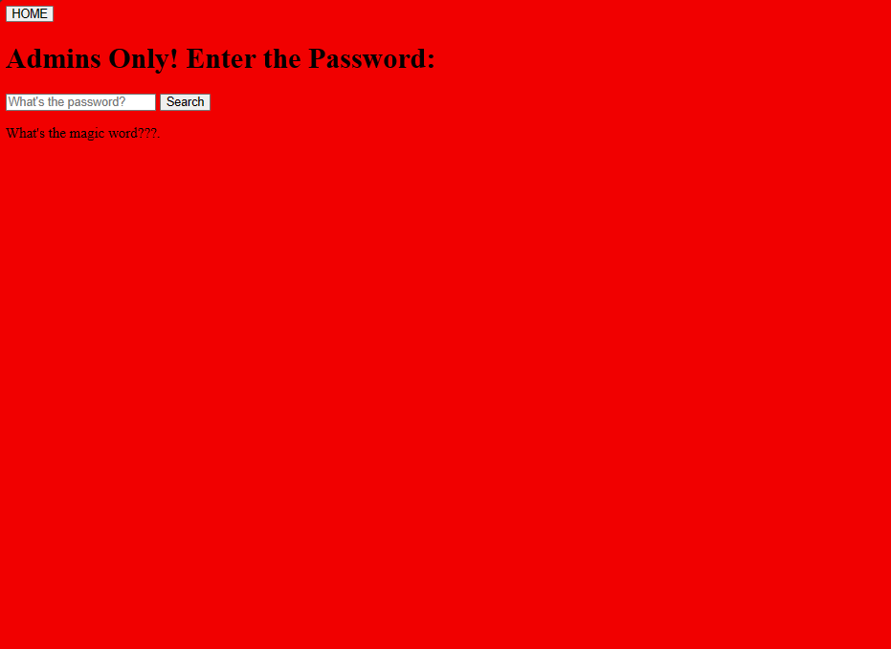
Admin Gateway
Red background associated with STOP sign, to indicate that most users should not be at this page.
HOME button in top left to allow quick turnaround (available on all pages)

Slide 7

Failed Password Check
Dead End, high contrast color to previous.
HOME button now in bottom right, harder to locate, negatively reinforcing unwanted behavior, as a deterrent.

Slide 8
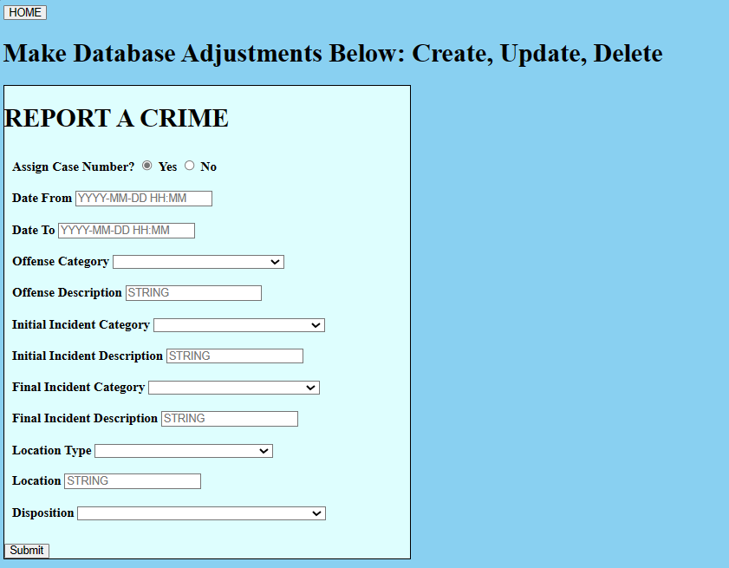
Admin Page (top)
REPORT is at top of page, since it will be used more than update/delete.
Case number assignment is bubble selection, defaulted to YES to prevent non-selection error.
Same drop-downs and placeholders used as SEARCH functions to ensure uniformity.

Slide 9
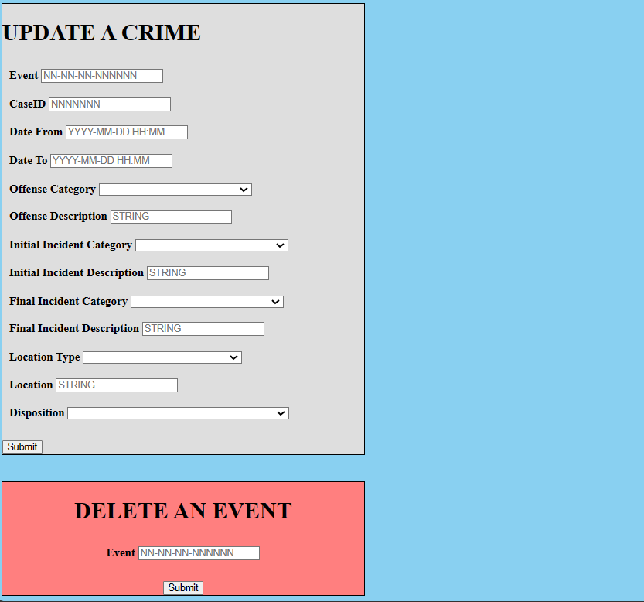
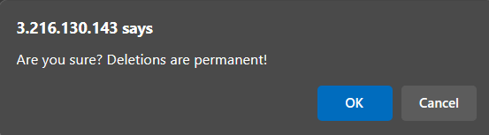
Admin Page (bottom)
UPDATE follows same format as CREATE function, with changes sent to specific inputted event to prevent spillage to other reports.
DELETE in red, to rapidly identify.
Pop-up warning used to prevent unwanted deletions

Slide 10
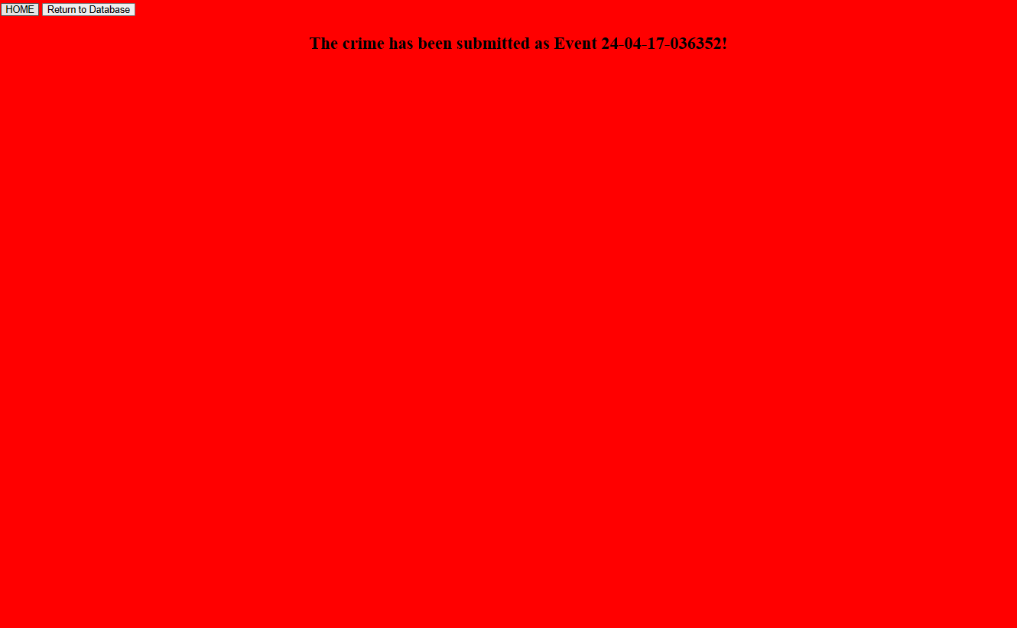
Crime Submitted
Event Number shown on screen for rapid copy.
Return to Database button available for subsequent alterations.
High contrast red from previous site to reinforce action taking place.

Slide 11
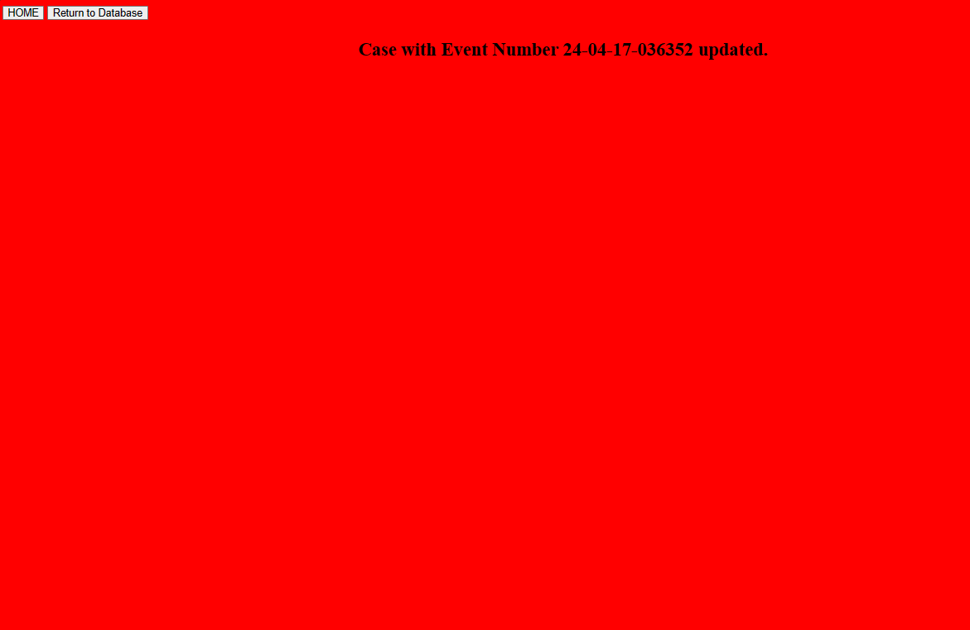
Crime Updated
Event Number shown on screen for rapid copy.
Return to Database button available for subsequent alterations.
Thematically identical to case submitted.

Slide 12
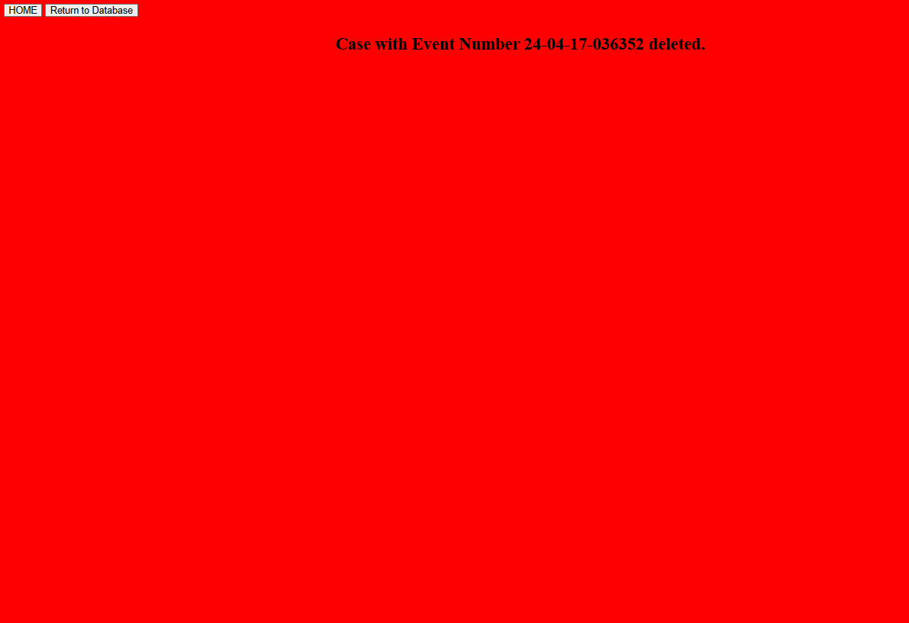
Crime Deleted
Event Number shown on screen for rapid copy.
Return to Database button available for subsequent alterations.
Thematically identical to case submitted/updated.

